Slide 1
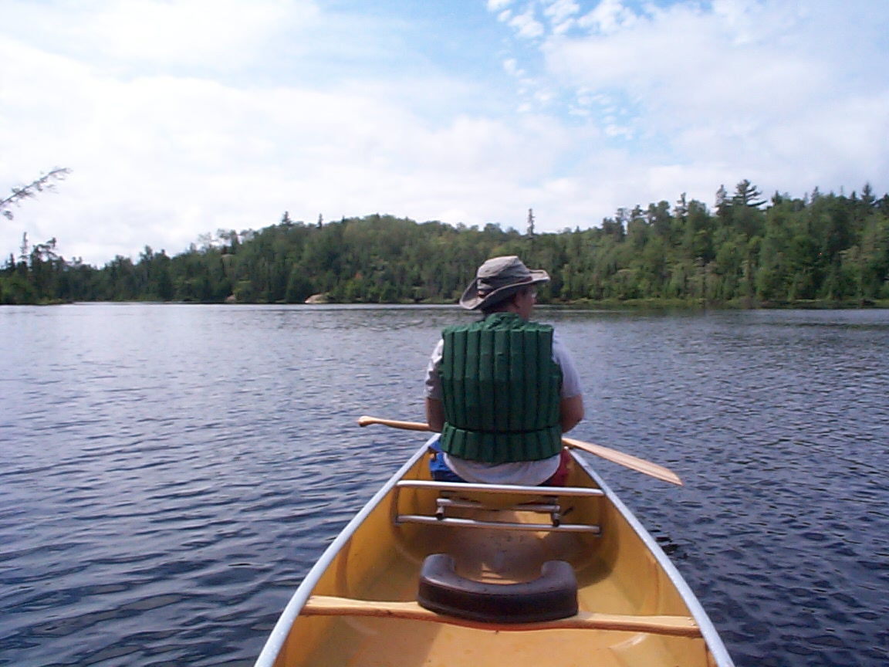
Earl out for a canoe ride in the Boundary Waters

Slide 2
